Slide 1
Bacterial Nutrition, Metabolism and growth
Dr. Sahar Mahdi

Slide 2
Nutrition:
is a process by which organisms acquire chemical substances ( Nutrients) used in cellular activities such as metabolism and growth.
Organisms differ in the use of particular elements their source and chemical form.
Microbial growth
is the cell division of a bacterium into two daughter cells, in a process called binary fission. Also refers to increase in number of cells, not cell size.
Metabolism:
Includes all the biochemical reactions that occur in the cell. It consist of anabolic and catabolic reaction.
Anabolism : is the energy- using processes.
Catabolism: is the energy- releasing processes.
Catabolism provides the building blocks and energy for anabolism

Slide 3
Physical requirements
Like ourselves, microorganisms do not live by food alone, they need a good environment . This is includes satisfactory . Range of Oxygen , Temperature , pH and Osmotic pressure.
Oxygen
All microorganisms require elemental oxygen to build their biochemical components, but not all microorganisms require at atmospheric oxygen.
The natural environment of microorganism is determined accordingly.

Slide 4
1- Strict( Obligate) Aerobes
These are microorganisms that can grow in the presence of air (O2) and the more O2 available , the better they grow.
Pseudomonas aeruginosa, Mycobacterium.

Slide 5
2- Facultative anaerobes
These microbes are able to grow in either the presence or the absence of air (O2) but they grow better when oxygen in present. Facultative pathogens are very common.
Escherichia , Enterococcus.

Slide 6
3- Microaerophilic bacteria
These microbes require oxygen , but they not grow in air that normally contains 20% oxygen only a few bacteria are microaerophilic, but some of these are important animal pathogens.
Campylobacter requires O2 levels below (2-10 %) for growth.

Slide 7
4- Strict anaerobic bacteria
These microbes lack the ability to grow in the presence of air and often even small amounts of O2 are toxic.
Clostridium
5- Aerotolerant anaerobes
Grow equally well in presence or absence of O2.
Streptococcus pyogenes.

Slide 8
Temperature
Temperature
Most bacteria grow throughout a range of approximately 20 Celsius degrees, with the maximum growth rate at a certain optimum temperature.
Psychrophiles: Grows well at 0 °C optimally between 0 °C – 15 °C
Psychrotrophs: can grow at 0-10 °C , optimum between 20-30 °C and maximum around 35°C
Mesophiles: Optimum around 20 – 45 °C
Moderate thermophils: Optimum around 55-65°C
Extreme thermophiles (Hyperthermophiles), Optimum around 80-113°C.

Slide 9
pH
pH
Acidophiles:
grow optimally between ph 0 - 5.5
Neutrophiles
Grow optimally between pH 5.5 - 8
Alkalophiles
Grow optimally between ph 8 -11.5

Slide 10
Osmotic pressure
As a result of the presence of a semi-permeable cytoplasmic membrane, bacteria a resemble other cells in being subject to ( Osmotic phenomena).They are tolerant of changes in the osmotic pressure of their environment and can grow in media with widely varying contents of salts, sugars and other such solutes .
Sudden exposure of bacteria to solutions of high salt concentration (e.g 2 to 2.5 %) sodium chloride may cause (Plasmmolysis).
Sudden transfer from a concentration to a weak solutions or to distilled water may cause (Plasmoptysis).

Slide 11
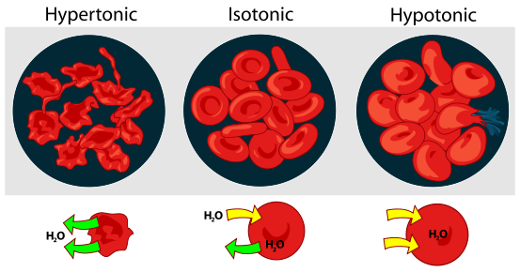

Slide 12
Chemical Requirements
1-Energy Source
Phototroph
Uses light as an energy source
Chemotroph
Uses energy from the oxidation of reduced chemical compounds.
2-Electron (Reduction potential )Source.
Organotroph
Uses reduced organic compounds as a source for reduction potential
Lithotroph
Uses reduced inorganic compounds as a source for reduction potential

Slide 13
3- Carbon source
Autotroph
Can use CO2 as a sole carbon source (carbon fixation)
Heterotroph
Requires an organic carbon source cannot use CO2 as a carbon source

Slide 14
4- Nitrogen source
Organic nitrogen
Primarily from the catabolism of amino acids
Oxidized forms of inorganic nitrogen
Nitrate( NO3) and nitrite (NO2).
Reduced inorganic nitrogen
Ammonium NH4
Dissolved nitrogen gas (N2) nitrogen fixation

Slide 15
Sulfur source
Organic sulfur
Oxidized inorganic sulfur
Sulfate SO4
Reduced inorganic sulfur
Sulfide (S or H2S)
Elemental sulfur (S)

Slide 16
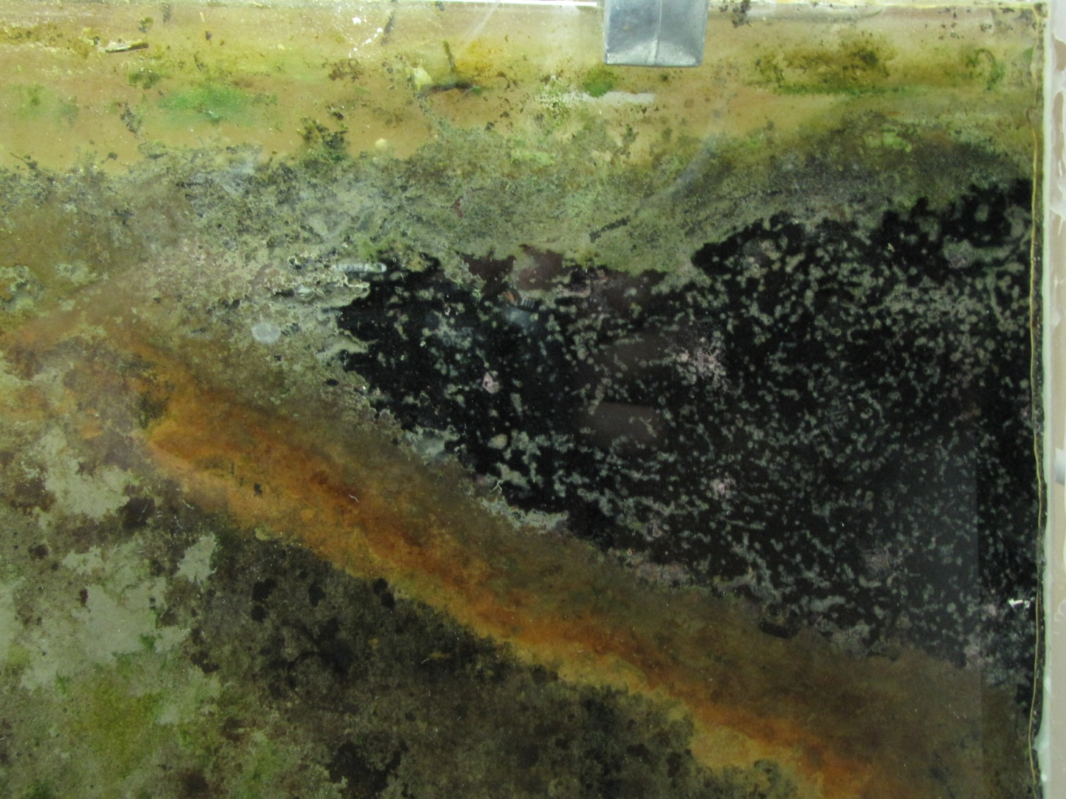

Slide 17
6- phosphate source
Organic phosphate
Inorganic phosphate (H2PO4 and HPO4)

Slide 18
Prototrophs vs. Auxotrophs
Prototroph
A species or genetic strain of microbe capable of growing on a minimal medium consisting a simple carbohydrate or CO2 carbon source with inorganic sources of all other nutrient requirements
Auxotroph
A species or genetic strain requiring one or more complex organic nutrient (such as amino acids, nucleotide bases or enzymatic cofactors) for growth

Slide 19
Special requirements (trace element)
Amino acids
Nucleotide bases
Enzymatic cofactors or vitamins

